Slide 1
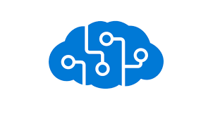
Knowledge Mining Platform CIE

Slide 2
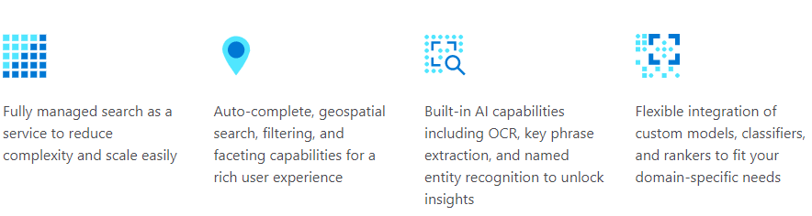
Azure Cognitive Search
Notes:
Azure Cognitive Search (formerly known as "Azure Search") is a search-as-a-service cloud solution that gives developers APIs and tools for adding a rich search experience over private, heterogeneous content in web, mobile, and enterprise applications. Your code or a tool invokes data ingestion (indexing) to create and load an index. Optionally, you can add cognitive skills to apply AI processes during indexing. Doing so can add new information and structures useful for search and other scenarios.
Key strengths include:
Azure data integration (crawlers) at the indexing layer
Azure portal for central management
Azure scale, reliability, and world-class availability
AI processing of raw data to make it more searchable, including text from images, or finding patterns in unstructured content.
Linguistic and custom analysis, with analyzers for solid full text search in 56 languages
Core features common to search-centric apps: scoring, faceting, suggestions, synonyms, geo-search, and more.
https://docs.microsoft.com/en-us/azure/search/cognitive-search-predefined-skills

Slide 3
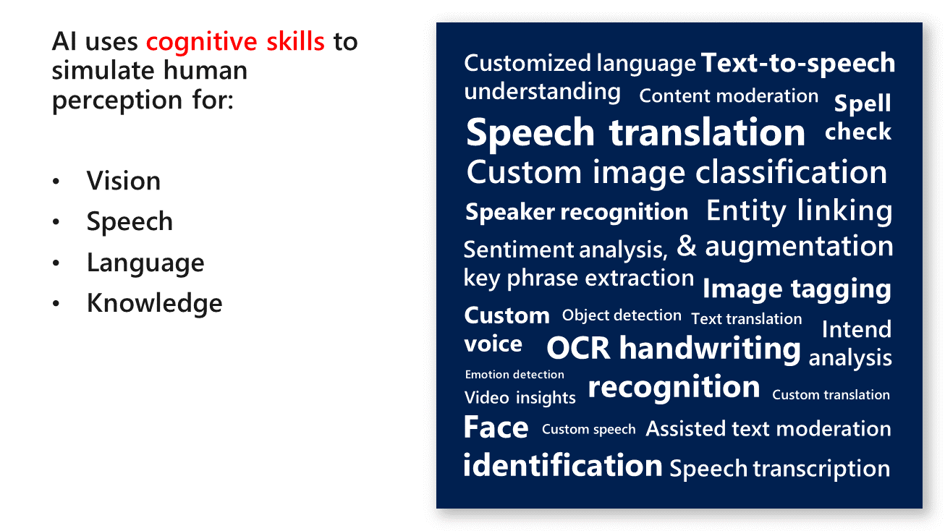
Cognitive Search uses AI :
Notes:
cognit

Slide 4
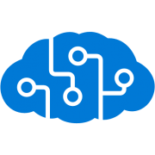
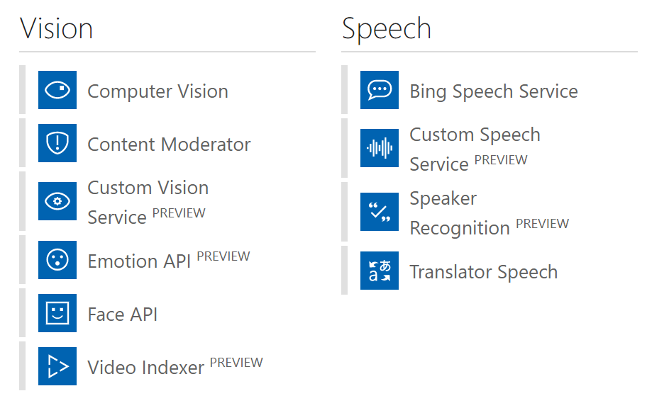
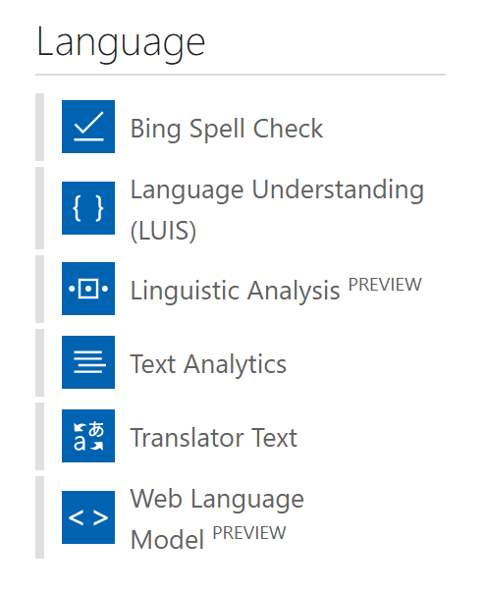
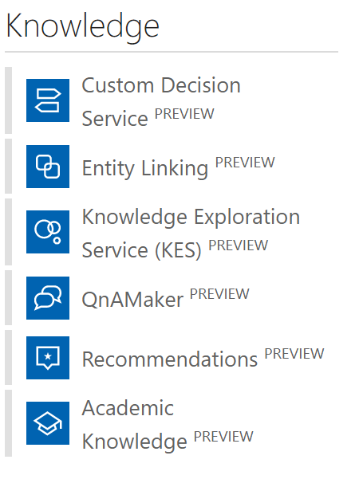
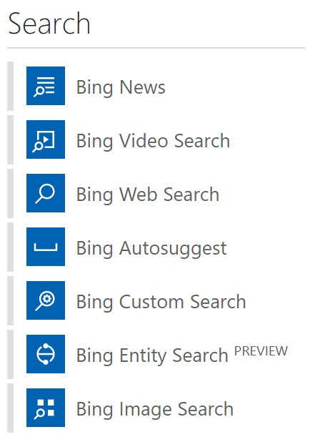
Cognitive Services
Notes:
29 comprehensive collection of intelligent and knowledge API to build smarter APPS
Available across platform
Easy integration with your experience
No background Machine learning
4

Slide 5
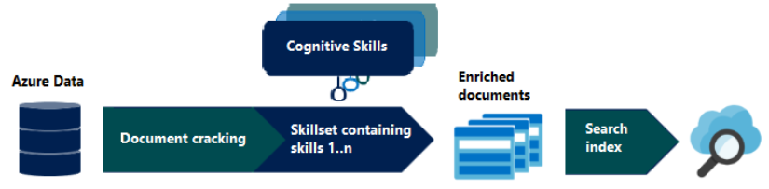
AI enrichment pipeline
https://docs.microsoft.com/en-us/azure/search/cognitive-search-concept-intro
Notes:
Azure Cognitive Search (formerly known as "Azure Search") is a search-as-a-service cloud solution that gives developers APIs and tools for adding a rich search experience over private, heterogeneous content in web, mobile, and enterprise applications. Your code or a tool invokes data ingestion (indexing) to create and load an index. Optionally, you can add cognitive skills to apply AI processes during indexing. Doing so can add new information and structures useful for search and other scenarios.
Key strengths include:
Azure data integration (crawlers) at the indexing layer
Azure portal for central management
Azure scale, reliability, and world-class availability
AI processing of raw data to make it more searchable, including text from images, or finding patterns in unstructured content.
Linguistic and custom analysis, with analyzers for solid full text search in 56 languages
Core features common to search-centric apps: scoring, faceting, suggestions, synonyms, geo-search, and more.
https://docs.microsoft.com/en-us/azure/search/cognitive-search-predefined-skills

Slide 6

AI enrichment pipeline
Notes:
Azure Cognitive Search (formerly known as "Azure Search") is a search-as-a-service cloud solution that gives developers APIs and tools for adding a rich search experience over private, heterogeneous content in web, mobile, and enterprise applications. Your code or a tool invokes data ingestion (indexing) to create and load an index. Optionally, you can add cognitive skills to apply AI processes during indexing. Doing so can add new information and structures useful for search and other scenarios.
Key strengths include:
Azure data integration (crawlers) at the indexing layer
Azure portal for central management
Azure scale, reliability, and world-class availability
AI processing of raw data to make it more searchable, including text from images, or finding patterns in unstructured content.
Linguistic and custom analysis, with analyzers for solid full text search in 56 languages
Core features common to search-centric apps: scoring, faceting, suggestions, synonyms, geo-search, and more.
https://docs.microsoft.com/en-us/azure/search/cognitive-search-predefined-skills

Slide 7
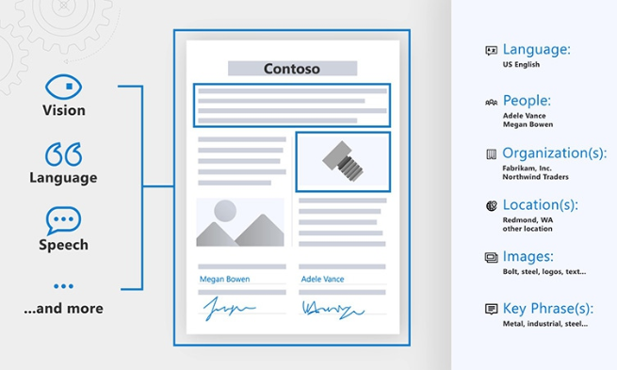
Azure Cognitive Search and Cognitives Services

Slide 8
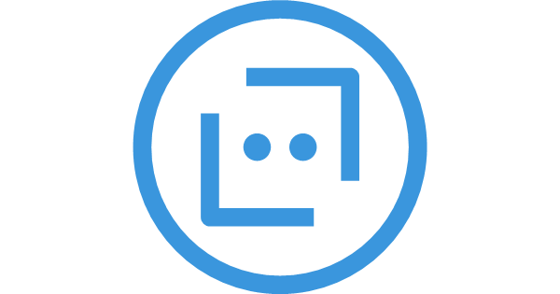
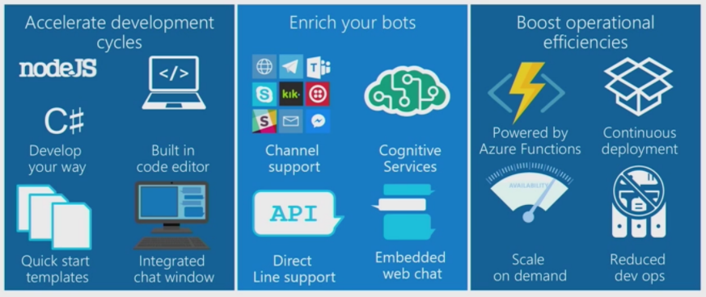
Bot Services
Notes:
Build, connect, deploy, and manage intelligent bots to interact naturally with your users on websites, apps, Cortana, Microsoft Teams, Skype, Slack, Facebook Messenger, and more. Get started quickly with a complete bot-building environment. You’ll pay only for what you use.
8

Slide 9
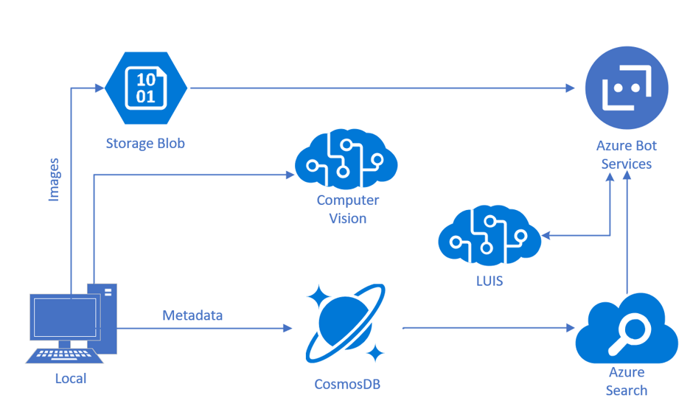
Integration
Notes:
Build, connect, deploy, and manage intelligent bots to interact naturally with your users on websites, apps, Cortana, Microsoft Teams, Skype, Slack, Facebook Messenger, and more. Get started quickly with a complete bot-building environment. You’ll pay only for what you use.
9

Slide 10
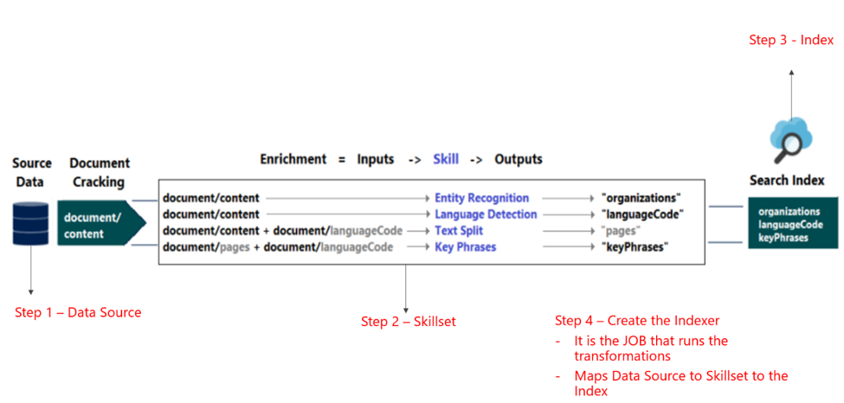
Lab 2 Architecture

Slide 11
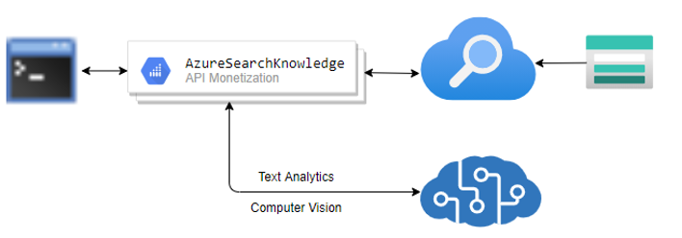
Lab 3 Architecture

Slide 12
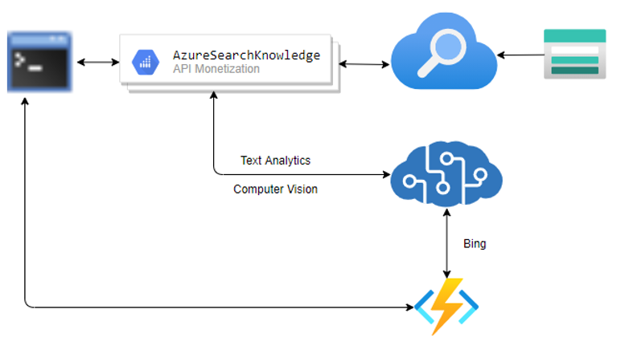
Lab 4 Architecture

Slide 13
Thank You.

Slide 14
Follow-up questions
msusdev@microsoft.com

